Slide 1
TEAM RESEED
Hack@IDF

Slide 2
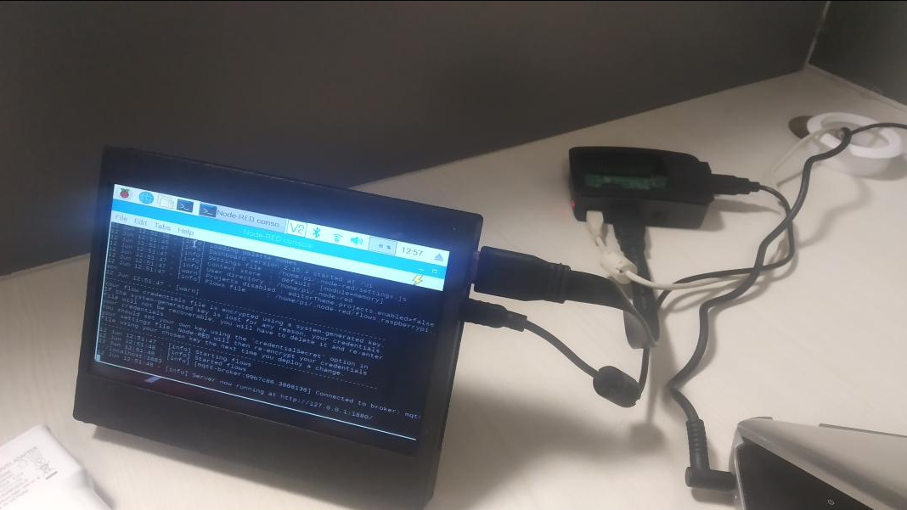
Hardware
Node Red Backend
(Touch Screen Interface)
Raspberry pi

Slide 3
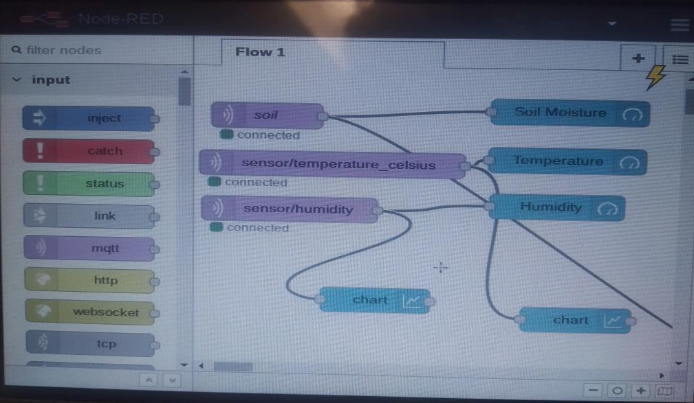
Node-Red Backend

Slide 4
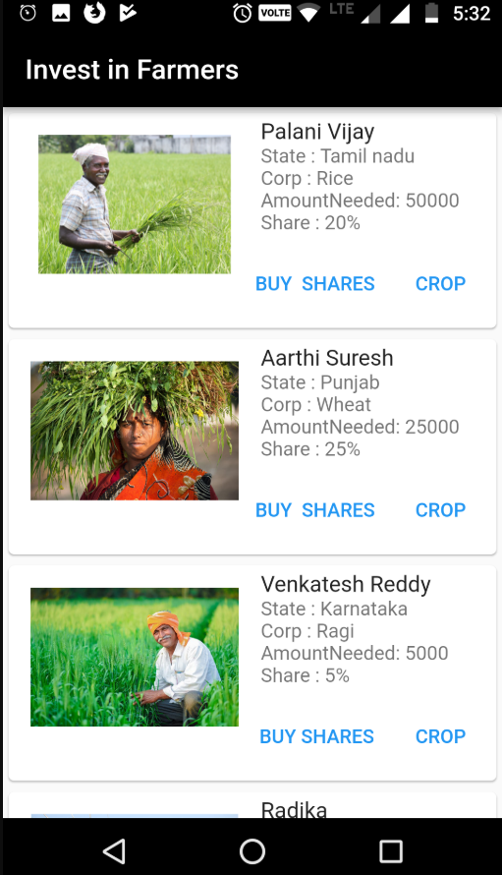
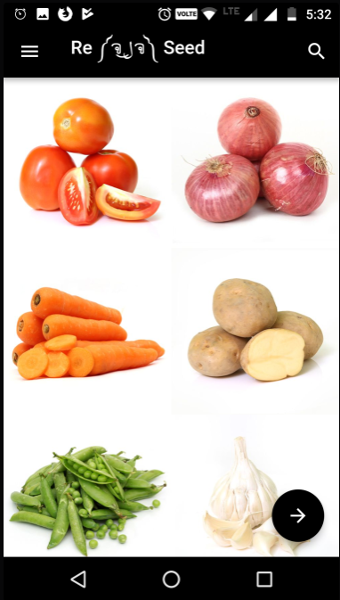
Mobile App

Slide 5
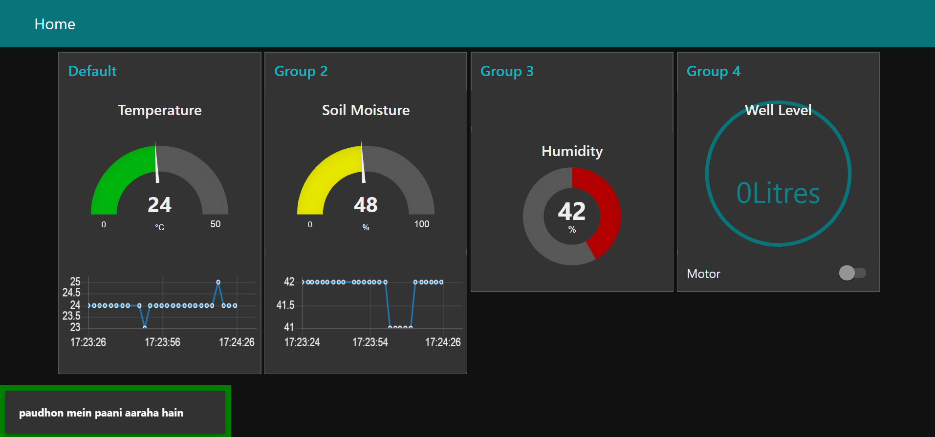
Node-Red Dashboard

Slide 6
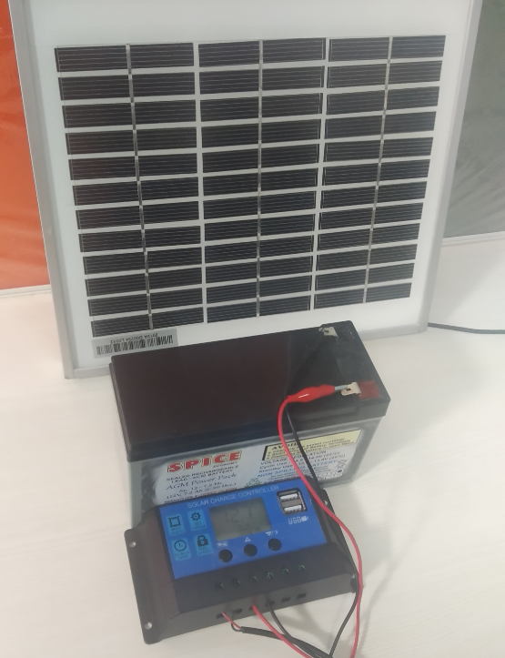
Hardware – Standalone 24/7 Solar Power
Solar Panel
Battery
Solar Charge Controller

Slide 7
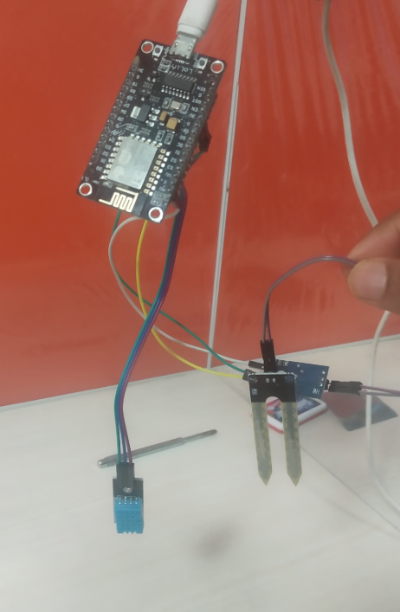
Node-Red Dashboard
NodeMCU
Soil Moisture Sensor
DHT 11 Temperature & Humidity Sensor
pH Sensor

Slide 8
Thank You IDF!
We loved it ☺

